Slide 1
SID-PRO
Life
University
Seasonal Infectious Disease Patient Reported Outcome

Slide 2
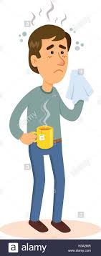
What is the SID-PRO?
The COVID-19 pandemic made it evident that healthcare professionals need a way to track symptoms over time, thus the idea of a patient survey was born. We did not want to limit the usefulness of the SID-PRO for only COVID-19, therefore we would like to expand the tool to include other common seasonal infectious diseases.
The SID-PRO is a survey of patient symptoms.
It’s purpose is for tracking symptoms, not diagnosing.

Slide 3
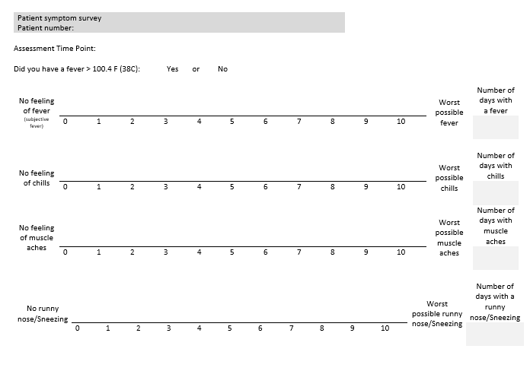
What will the SID-PRO look like?
The SID-PRO is a scale-based patient questionnaire where patients will rate their current symptoms on a scale of 1-10.

Slide 4
As a starting point, we considered the 71 infectious diseases from the article “The calendar of epidemics: Seasonal cycles of infectious diseases” by Micaela Elvira Martinez for SID-PRO.

Slide 5
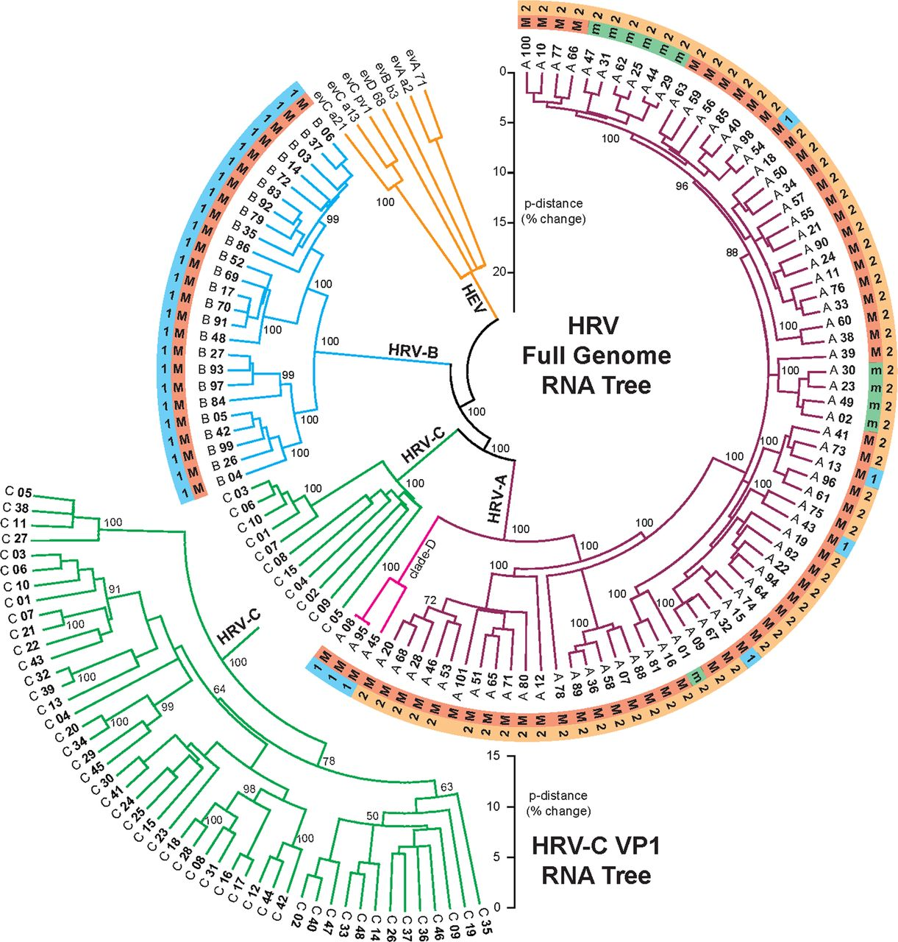
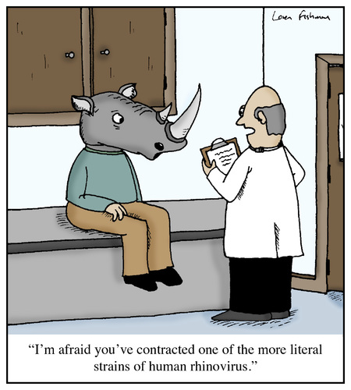
In addition to COVID-19, we included the common cold (Rhinovirus), to our list of seasonal infectious diseases.
*Human Rhinovirus includes hundreds of different mutated strains, as seen in the chart to the right.

Slide 6
Based on sources from the Centers for Disease Control (CDC), these are the different methods a virus can spread:
Transmission Styles:
Direct Transmission
Indirect Transmission
Sexually Transmitted Disease
Droplet Spread
Skin-on-Skin
Air-borne
Vehicle-borne
Vector-borne
Food-borne
Water-borne
Fomite Transmission
Soil Transmission
Zoonotic
Yes
No

Slide 7
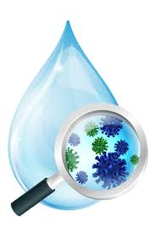
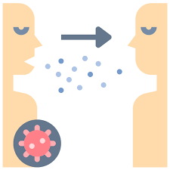
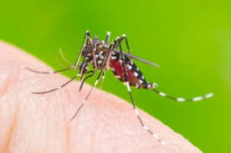
We included the seasonal infectious diseases that fit within the following criteria:
Non-zoonotic
Over 5,000 cases a year in the United States.
Indirect Transmission: Air-borne, Food-borne, Water-borne, or Fomite Transmission.
Direct Transmission: Droplet Spread only.
*We eliminated the diseases that could be transmitted sexually, by skin-on-skin contact, zoonotically, or through a vector (insect). We also choose to exclude zoonotic and vector-borne diseases because they require an intermediate host.

Slide 8
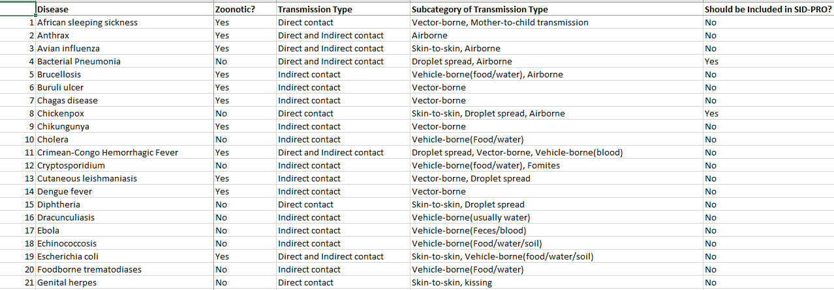
Provided below is an example of our infectious disease classification:
*This only shows 21 diseases, but we classified a total of 71 infectious diseases.

Slide 9
Finally, we narrowed it down to the following 13 seasonal infectious diseases:
1. Bacterial Pneumonia
2. Chicken Pox
3. Haemophilus Influenzae
4. Herpes Zoster (Shingles)
5. Influenzae
6. Pertussis
7. Respiratory Syncytial Virus (RSV)
8. Rotavirus
9. Shigella
10. Tuberculosis
11. Viral Meningitis
12. Rhinovirus (Common Cold)
13. SARS-CoV-2

Slide 10
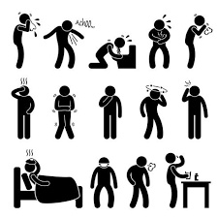
Next, it was time to determine the symptoms of each of the 13 seasonal infectious diseases. We used peer reviewed articles and the Centers for Disease Control sources to compile the following list of symptoms:
1. Cough | 10. Itching/Rash
2. Congestion | 11. Chest Pain/Tenderness
3. Diarrhea | 12. Sneezing/Running Nose
4. Headache | 13. Abdominal Pain
5. Sore Throat | 14. Chills
6. Fever | 15. Muscle Aches
7. Shortness of Breath | 16. Vomiting
8. Fatigue | 17. Loss of Smell Taste
9. Nausea

Slide 11
In order to ensure that we have selected the appropriate seasonal infectious diseases and related symptoms, we would appreciate your expert opinion.

Slide 12
1. You will be asked to complete a survey.
2. You will be asked if the diseases and symptoms on our list should be included/excluded as part of the SID-PRO.
3. You will also be asked if we should include other diseases or symptoms that have not been mentioned thus far.
Here is how we would like your assistance:
Then we will use your expert opinion to modify the SID-PRO accordingly.

Slide 13
If you are willing to participate, you may click the link provided below for direct access to the survey!
https://hipaa.jotform.com/203524569844160

Slide 14
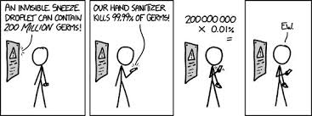
Thank you!
We appreciate your time and attention!

